Slide 1

Jenkins
Murali Arandala
6145

Slide 2
What is Jenkins?
Jenkins is a tool that is used for automation, and it is an open-source server that allows all the developers to build, test and deploy software. It works or runs on java as it is written in java. By using Jenkins we can make a continuous integration of projects(jobs) or end-to-endpoint automation.

Slide 3
why we use it?
With Jenkins, organizations can accelerate the software development process through automation. Jenkins integrates development life-cycle processes of all kinds, including build, document, test, package, stage, deploy, static analysis, and much more.
Jenkins achieves Continuous Integration with the help of plugins. Plugins allow the integration of Various DevOps stages. If you want to integrate a particular tool, you need to install the plugins for that tool. For example Git, Maven 2 project, Amazon EC2, HTML publisher etc.

Slide 4
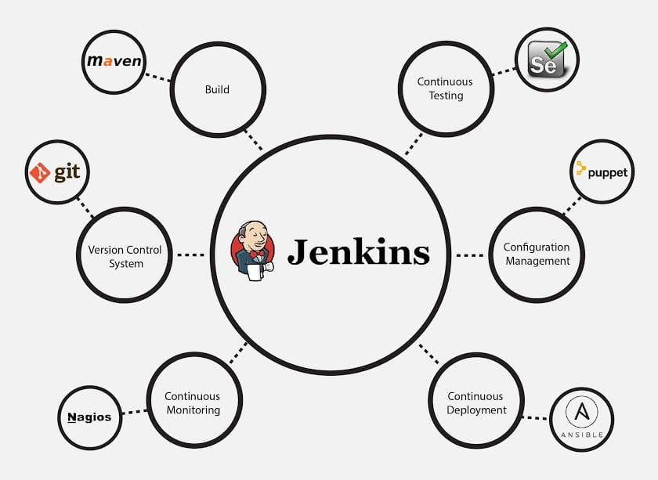

Slide 5
Advantages of Jenkins
It is an open-source tool with great community support.
It is easy to install.
It has 1000+ plugins to ease your work. If a plug-in does not exist, you can
code it and share it with the community.
It is free of cost
.It is built with Java and hence, it is portable to all the major platforms.

Slide 6
Thank you

